Slide 1
Autism Spectrum Disorders (ASD)
Common work-related challenges & possible solutions

Slide 2
Who we are:
Jessica Corneau, Regional Director, Southern Region, ADS/BRS
Maureen Woronecki, Supervisor, Northern Region, ADS/BRS
Amy Huysman, Supervisor, Youth Services Unit, ADS/BRS
Carly Duffy, Workforce Projects Coordinator, Workforce Outreach Team, ADS/BRS

Slide 3
If you’ve met one person with ASD…
You’ve met one person with ASD

Slide 4
Diagnostic Criteria
An individual must have persistent deficits in three areas of social communication/interaction:
Social-emotional reciprocity
Nonverbal communicative behaviors (eye contact, body language, use of gestures, etc.)
Developing, maintaining and understanding relationships
AND

Slide 5
Diagnostic Criteria (Continued)
At least two of four types of restricted, repetitive behaviors:
Stereotyped of repetitive motor movements, use of objects or speech (lining up toys, echolalia, etc.)
Insistence on sameness, inflexible adherence to routine, or ritualized patterns of behavior (i.e., difficulty with change/transition, eating the same foods every day, etc.)
Highly restricted, fixated interests that are unusually intense or focused
Hyper- or hypo-reactivity to sensory input (very uncomfortable in certain clothing textures, fascination with lights, indifference to pain/temperature)

Slide 6
Let’s start with possible strengths!
May be reliable and dependable employees
May be good with following routine, repetitive procedures and tasks with accuracy and speed
May pick up on things that others might miss
May be engaging, charming, interesting, and fun to be with
May have a great sense of humor!

Slide 7
Primary areas of challenge w/work:
Social and communication difficulties
Executive Functioning limitations (allows us to plan, set and meet goals, refer to prior experiences, complete tasks and manage our emotions)
Sensory limitations (tactile, noise, light, smells, etc.)

Slide 8
Social and Communication Challenges
May have restricted communication OR talking a lot but with superficial or repetitive content
May have difficulty with understanding the work culture and social interactions; may seem to just not fit or be out of step with others
May be blunt, which can feel rude to some coworkers. May be perceived as irritating/annoying (although they are not trying to be!)
May say inappropriate things**
May like to focus on facts and exhibit poor conversational skills (difficulty with reciprocity)

Slide 9
Executive Functioning limitations may look like…
Exhibit rigid and restricted thinking and behavior
Difficulty organizing work and their time

Slide 10
Rigid and Restrictive Thinking and Behavior
May have problems with figurative language and idioms (i.e., sarcasm)
May present with motor mannerisms/stereotypies/atypical voice tone
May have focal interests (i.e., intense interest in specific subject)

Slide 11
May have some “compulsive” traits and like to do things a certain way
May have difficulties with change or transitions
May be very rule governed; may “police” others and point out rule violations

Slide 12
As a result of many of the prior challenges, they may struggle with doing things in the way that someone else thinks they should because their way makes more sense to them

Slide 13
Difficulty reading others’ emotions and/or controlling their own
May have difficulty reading others’ emotions (may be perceived as a lack of empathy)
May experience challenges managing own emotions
May say blunt or hurtful things without understanding why they were hurtful
May become frustrated, anxious, and/or overwhelmed to the point of becoming emotional or having outbursts

Slide 14
Sensory issues
May not tolerate noisy, chaotic environments; can become overstimulated
May only tolerate very soft, loose clothing
May not be able to tolerate certain smells or sounds (both can be a challenge in the break/lunchroom)

Slide 15
Strategies and Resources for Working with Individuals on the Spectrum
Notes:
maureen

Slide 16
Job Coaching

Slide 17
Purpose of Job Coaching
Job Coaching is used in an employment setting when an individual is employed and is in need of one of the following:
Skill Development
Deficit Remediation

Slide 18
Critical Components of Job Coaching
Preparing and Pre-teaching
Communication among all parties i.e. employee, employer, job coach and family
Observing and collecting data
Teaching, checking for understanding and providing feedback
Identifying strategies and tools
Establishing natural support
Fading Supports

Slide 19
Know your Learner
Systematic- Learn best through repetition
Visual- Learn best when things are shown or modeled
Concrete/Literal- Needs explicit instructions
Difficulty Generalizing- Teach skills in environment and try to draw connections
Passive/Dependent- Teach individual to use non social supports or cues. Avoid giving permission to move on to next task. Give the information so they can proceed.
Inflexible/Rigid- Rule bound- Will need to learn exceptions to the rules and build upon structure.
Sensitivity/Sensory- May need to avoid certain environments

Slide 20
Strategies in Job Coaching
Communication
Establishing a communication plan is critical
Employee
Employer
Counselor and other key players
Observing and Collecting Data
Task Analysis: Find out what the job duties are and put them into a format that the employee best understands (e.g., a map of the area, a list of duties, a job description). Break down tasks as appropriate for individual
Identify natural supports in the workplace that the individual can use for job support, and social connections

Slide 21
Strategies
Self Regulation
Teach strategies to self monitor
Build in self monitoring to schedule
Build in check ins with employer/supervisor
Examples:
Check list and schedules
Clocks/timers
Reminders/Calendar alerts
Processing Job and Social Information
Pre teach
Feedback in the moment
Role play “Do’s and don’ts to maintain a job”
Scripts- “Networking” “Introductions”
Situational Rules- Examples: “Avoiding touchy subjects and Insults” “Do’s and don’ts to maintain a job”

Slide 22
Strategies
Communication and Language for Supervisor/Instructors
Concrete specific instructions
Reminders about volume
Check for understanding
Clear expectations
Be mindful of processing time
“Read between the lines”- If supervisor uses a lot of figurative language- help employee decode.
Perspective Taking for Employee
Looking beyond your own point of view
Intention VS. Perception

Slide 23
Strategies
Problem Solving
Size of Problem
Use Problem Solving tool
Reaction to Problem (“A five will get you fired”) – see next slide
Identifying possible solutions
Who to go to for certain problems
Maintaining Motivation
Figure out what motivates individual
Goal Setting- Gratification/Self Gratification

Slide 24
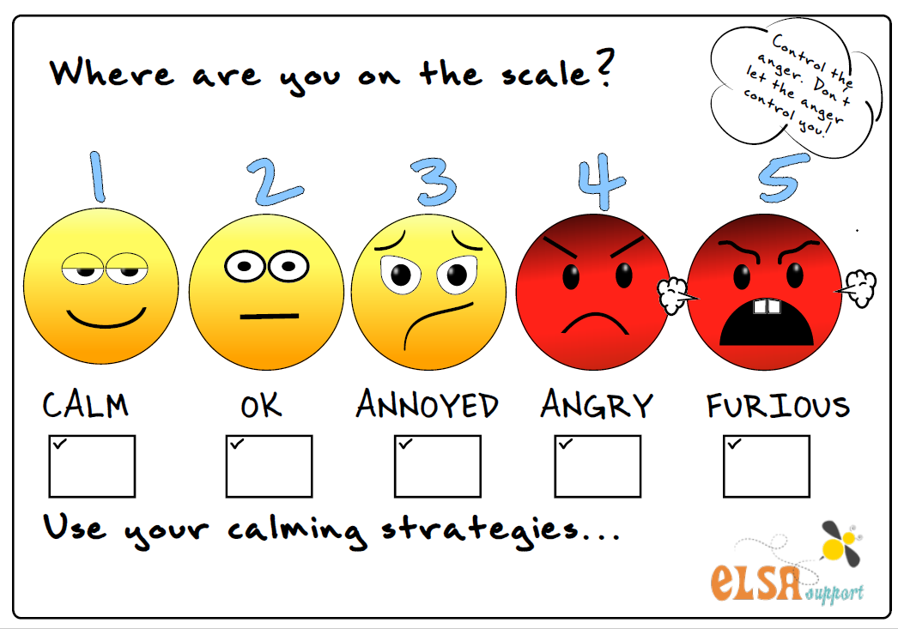

Slide 25
Teaching/Coaching Strategies
Modeling- Go slowly and show each step you are doing. Narrate steps as you are demonstrating.
Visuals- Pictures, lists, reminders embedded, maps, Assistive Tech
Gestures-Subtle prompting. May point at what is next, use touch, or use a watch/timer to indicate time to switch tasks.
Rehearsing- Rehearse steps. Review frequently.

Slide 26
Teaching/Coaching Strategies
Verbal- Instruction-Explain how to perform the task
Avoid the use of subjective terms
Use concrete and concise language
Provide immediate feedback
Present one task at a time
Allow for practice of verbal instruction
Be mindful about relying on verbal instruction too much. Hardest to fade

Slide 27
Natural Support
A natural support approach refers to enhancing or linking individuals to existing social supports in the work environment that are available either informally (from co-workers and peers on the job) or formally (from supervisors and company sponsored employment programs)
Natural Supports are everywhere!
Observe what works and possibility for modification of existing systems
Co-workers

Slide 28
Fading Support
Important to have a plan on how support will be faded

Slide 29
Level Up providing Pre-Employment Transition Services
to high school and transition age students in Connecticut
Notes:
Amy

Slide 30
What is Level Up?
Pre- Employment Transition Services and activities to help prepare students for their career or post-secondary education path.
Students, ages 16- 22, who have an IEP, 504 Plan, or documented disability and are potentially eligible for Vocational Rehabilitation Services may participate.
Supplemental to services and opportunities the student may already be receiving in school.
Short term in nature.
Through these services, students are better equipped with the skills and knowledge needed to be successful in the 21st-century workforce.
Notes:
ME

Slide 31
Employer Perspective: Critical Skills
Soft Skills are critical in all industries and career pathways. Here are some of the skills employers rate most important for job success.
Professionalism and Work Ethic
Critical Thinking and Problem Solving
Teamwork and Collaboration
Communication
Taking initiative and Growth Mindset

Slide 32
Preparing for Success
Build Skills
Home, School and Community offer opportunities to teach, practice and reinforce essential work skills.
Little things can make a huge impact. Example: Instead of parent or teacher sending the email on behalf of the student. Student works with teacher or family to draft the email together .
Gain Work Experience
Get Involved
Becoming involved in volunteer, clubs or other activities provides additional opportunities to build ones network, gain experience and stand out to employers when applying to jobs.

Slide 33
Level Up Service Areas:
Instruction in Self Advocacy
Career Exploration
Work Based Learning Experiences
Workplace Readiness Training
Post Secondary Educational Counseling

Slide 34
Employment Goals and Understanding Career Pathways
Notes:
Carly

Slide 35
Career Pathways
Assessment & Exploration
Planning & Preparation
Personal Effectiveness & Occupational Competencies
Skills to Pay the Bills
ACT Work Keys
Conover
Allison
Metrix Learning
Khan Academy
Workforce Micro-training
Education & Training
Career Pathway Foundational Trainings
Workforce Training
Credit towards Academic degree
OJT or Internship
ISTPP
Metrix Learning
Pre-Apprenticeship
Industry Recognized Credential
Placement & Advancement
Entry Level through Advancement Opportunities
Job Placement (Entry Level Affiliation)
Alternative Placement (CPO, OJT, Paid Internship)
Apprenticeship
Career Advancement
Interest/Skills/Preferences
WOWI
Conover
Career Index Plus
Competency Models
SHL
May Require Education & Training Resources

Slide 36
Example of a Career Pathway
Exploration Assess skills and interests Participate in Informational Interviews and Job Shadowing Volunteer Begin a portfolio Access industry specific training programs to build skill and experience | Graphic Design Intern Enrolled in Bachelor Degree Program Proficiency in Microsoft, Adobe, etc. Build a portfolio Ability to provide design samples and multitask | Junior Graphic Designer Bachelor’s Degree 2-3yrs experience in the industry Proficiency in Microsoft, Adobe, Graphic Design software Continue to build a portfolio Ability to multitask, work under pressure and meet deadlines | Graphic Designer Bachelor’s Degree 3+yrs experience Proficiency in various graphic related software Provide a portfolio Ability to multitask, work on a team, work under pressure and meet deadlines

Slide 37
Any questions?

